Slide 1
What is an option?
A financial derivative that represents a contract sold by one party (writer) to another party (holder)
It offers the holder the right, but not the obligation, to exercise the option to either buy or sell an underlying asset when predetermined conditions are met

Slide 2
How Options Function
Option = f(S, K, T, r_{f}, σ)
S = share price
K = strike price
T = time to maturity
r_{f} = risk free rate
σ = volatility of underlying asset

Slide 3
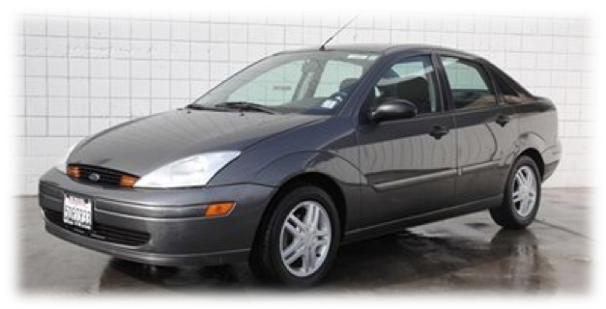

2 Types of Options
Vanilla Options (2 forms)
  American Option
  European Option
Exotic Options (unlimited)
  Bermuda Options
  Chooser Options
  Performance Options
  Compound Options
  Binary Options
  Barrier Options
  Asian Options
  Lookback Options
  Etc.

Slide 4
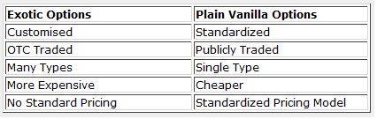
Exotic Options
The term “exotic” was popularized by Mark Rubinstein in 1990
Used to describe any option that is more complex than a vanilla American or European option

Slide 5
Exotic Options
Exotic options alter some of the characteristics of a standard (plain vanilla) options:
  Time to Maturity (e.g. Barrier)
  Exercise Price (e.g. Lookback)
  Position (e.g. chooser, Swing)
  Underlying Asset (e.g. Quantos, Asian)
  Payoff Structure (e.g. Binary)

Slide 6
Binary Options
It either pays out or it doesn’t
2 types
  Cash-or-Nothing
    Pays the fixed amount if the asset is “in-the-money”
  Asset-or-Nothing
    Pays the value of the underlying

Slide 7
Why Binary and Barrier Options?
You don’t have to be an expert trader
You know the risk and payoff
Short time to maturity
High payout
  ROI of 50-70%
  Linked to the direction the asset trending and not the difference in price

Slide 8
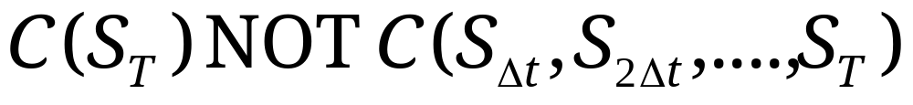
Path Dependent Options
Note that for regular options the option payoff does not depend on how it got there. For example the above call option paid $9.046 since S in three months is 109.046. The payoff depended on S_{1/4} with no dependence on how it got to the final value (i.e. uud or udu or duu).
Mathematically:

Slide 9
Path Dependent Options
Path Dependent Options have payoffs that depend on previous values the asset takes.
Mathematically, the value of the option at expiration is:
To make the notation easier we will use subscripts for the step in the tree (as opposed to calendar time in years).

Slide 10
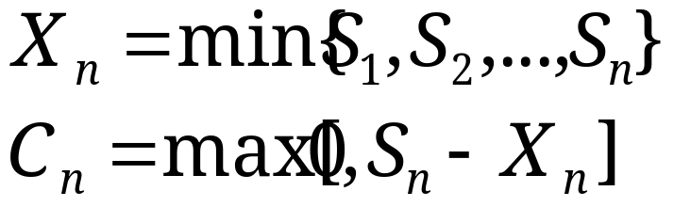
Lookback Options
Our first path dependent option are lookback options.
Lookback (Call) Options on the Minimum
  Strike Price at Expiration:
Example: 6 month lookback call on the Japanese Yen. Importer can buy a lookback option that allows her to purchase yen at the lowest price that occurs in 6 months.

Slide 11
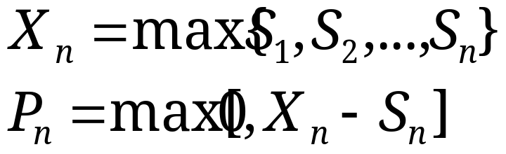
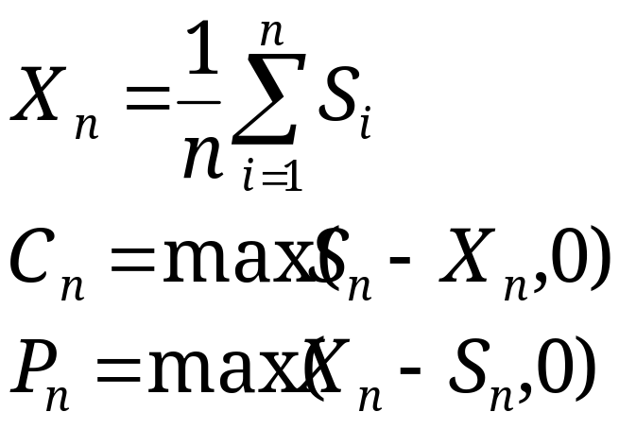
Lookback Options
Lookback (Put) Options on the Maximum
  Strike Price at Expiration:
Lookback Options on the Average

Slide 12
Asian Options
Originated in Tokyo, Japan in 1987
Payoff is based on the average price of the asset over a pre-set period of time
Fixed Strike – payoff is the difference between the strike price and average value
Floating Strike – payoff is the difference between value at expiration and average value

Slide 13
Average Rate Options
These are also known as Asian options although I find this an unfortunate name since these Asian options can be American or European style options.
The lookback options had the exercise price being random and changing with time. Average Rate Options have a fixed exercise price but a random underlying asset value.

Slide 14
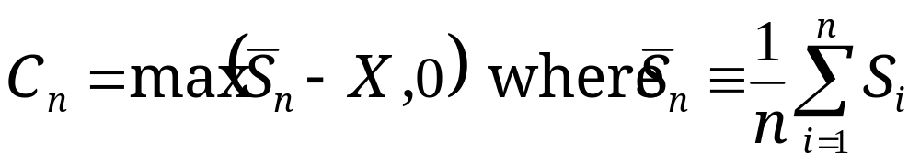
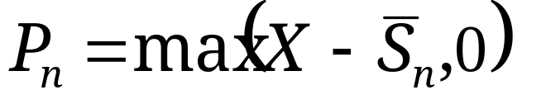
Average Rate Options
The Call will pay off, at expiration,
Similarly for the put,

Slide 15
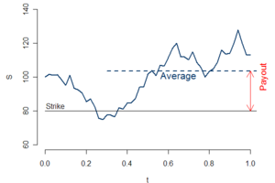
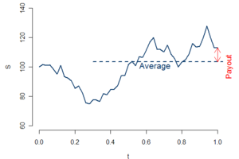
Asian Option Example
Fixed Strike
Floating Strike
Average = $102
Pre-Set Strike = $80
Call Payout = $22
Put Payout = $0
Average = $102
Strike @ maturity = $110
Call Payout = $0
Put Payout = $8

Slide 16
Analytical Approximations
If the averages are geometric (i.e. the nth root of the product) we can get an exact formula.
There are several approximations you can use for arithmetic averages. See pp. 468-469 if you are curious (you will not need to know this analysis).

Slide 17
Why Asian Options?
Reduce the dependence of the value of the option on the spot price of the asset on a specific date
Less expensive because its volatility is usually less then the underlying assets spot price

Slide 18
Barrier Options
An immediate rebate barrier option pays a given rebate as soon as a barrier is reached.
Example: Up & Out Call Option has a payout of Max(0, S_{n} - X) only if the stock price fails to reach a certain level, call it H. If the stock reaches this barrier, the call option will be exercised, paying H - X.
IMPORTANT: The text (and the formulas) assume no rebate; i.e. Up and Out terminates with no payment of H - X. We can adjust this by adding (H-X)P*(S>H).

Slide 19
More “Knockout” Options
Down & Out Call Option: If the stock price falls below a threshold, H, the option immediately expires worthless.
Up & Out Put Option: If the stock price rises above a threshold, H, the option immediately expires worthless.
Down & Out Put Option: If the stock price falls below a threshold, H, the option is immediately is exercised: Value X - H. (Again text assumes no rebate).

Slide 20
“Knock-in” Options
These will become exercisable only if they attain a barrier H (with a particular direction).
A Down and In Call will become exercisable (essentially it will “exist”) only if the stock price falls below a threshold H<X.
Up and In Put: Exist only if S rises above a threshold H>X.

Slide 21
Complex Threshold Rules
The terms of knocking in and out may not be as simple. For example a baseball option is a regular call option that gets knocked out (becomes worthless) if closing price falls below the threshold on three different days (prior to expiration).

Slide 22
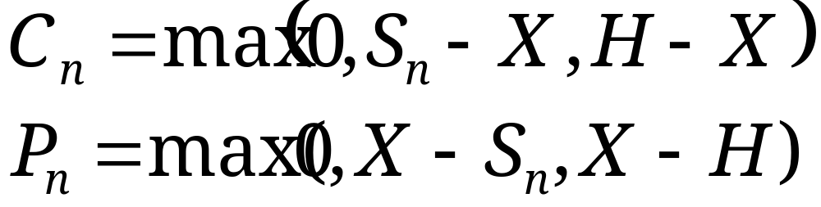
Cliques & Ladders & Shouts
(Oh My!) We can classify a set of options with payoffs
H is determined by some rule. If H = X we have an ordinary option.
In general, H is random.

Slide 23
Cliques & Ladders & Shouts
If H is the maximum price then the call has a lookback feature that gives the right to buy for X and sell it not at the spot price @ expiration (S_{n} ) but the highest price during the life of the contract.
If H is the stock price at a single pre-determined date then it is a one-click option.

Slide 24
Ladders
If H is a predetermined level only if it is reached by the stock, otherwise it is X, then the option is a one-rung-ladder. Can you guess what a two-rung-ladder is?
H
H
Left Figure, Option will pay at least H - X. Right figure is a regular call option (so far).

Slide 25
Shouts
H is the (contemporaneous) price at any moment the buyer chooses. (Could have multi-shout contracts also).
Let us try to price an at-the-money shout option.
Same Idea: Work backwards asking each step: “to shout or not to shout”?

Slide 26
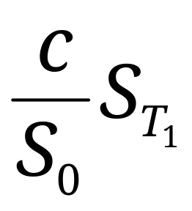
Others: Forward Start
Typical executive compensation contracts. You will receive an at the money option some date in the future, T₁. Note that at-the-money options are proportional to the stock and exercise price. Let c be the value of a current at the money option with the same duration. An at-the-money call at T₁ will be worth

Slide 27
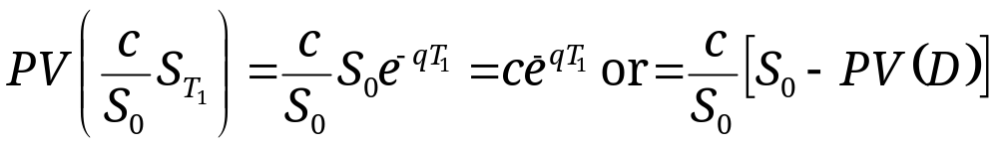
Forward Start Options
What is the current value? Well the constant is known today hence we need the present value of the future stock price. We’ve done this enough:

Slide 28
As You Like It
These chooser options allow the holder to choose, during a specified time period, whether the option is a call or a put.
Assume the choice must be made at T₁ then the value of this option at that time is max(c,p). If the options are both European and have the same strike price we can use put-call-parity for valuation.

Slide 29
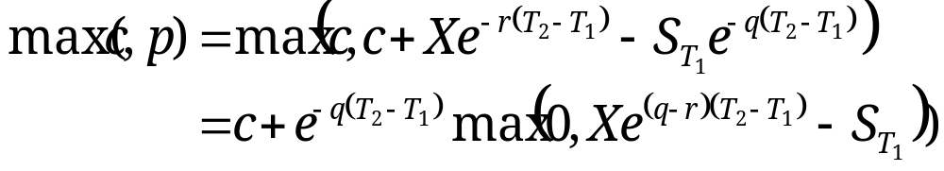
As You Like It
Let T₂ be the expiration date of the options on which the chooser is based. PCP at time T₁ yields:
Result, Cost today is identical to the cost of this standard option strategy:

Slide 30


Rainbow Options
These are options that depend on more than one risky asset.
Exchange Options: A call on asset A with exercise price being the price of asset B. This pays max( S_{A} - S_{B} , 0) at expiration.
Option on the Best
Call on the Minimum

Slide 31
Other Options
Spread Options: Based on the difference between two prices, e.g. Max(0,S_{A} - S_{B} )
Digital/Binary Options (pp. 464-465)
  Cash or Nothing Options will pay a fixed amount if the option is in the money. Can you price a European digital option using Black-Scholes?
  Asset of Nothing Options will pay the stock value if in the money.

